Slide 1
Welcome dear jury members

Slide 2


Java / POO / UML project
Presented by :
-NGATAT Herman
SEUNGTO Stephan
TATUE Fabrice
-WAMBO Harley
Under the supervision of:
M. ALOYS NGUEPI
Training manager :
M. KUATE Tanguy

Slide 3
Plan de travail
Introduction
Context
Problematic
Objectives and needs
Project organisation
Financial study
Project implementation
Conclusion

Slide 4
Introduction

Slide 5

2
context

Slide 6
Rewrite an old Boulder Dash game

Slide 7

3
Problematic

Slide 8
How to produce a code respecting the features of the game?

Slide 9
4
Objectives and needs

Slide 10
Objectives
1
write a marven code
2
perform unit tests
3
Make diagrams
Create a database to store levels
4

Slide 11
Needs
1
Test of the game
2
MY SQL connectors
3
The images of the different objects of the game
the GIT HUB tool
4

Slide 12

5
Project organisation

Slide 13
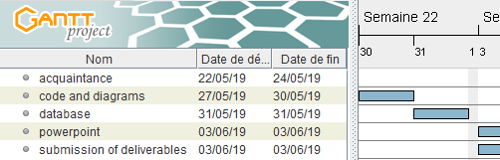
Provisional schedule

Slide 14
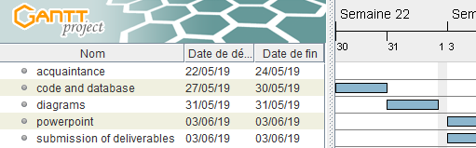
Real Schedule

Slide 15

Resources
Material

Slide 16

Resources
Software

Slide 17
Resources
Human
participating names
NGATAT Herman
SEUNGTO Stephan
TATUE Fabrice
WAMBO Harley

Slide 18
Project duration
14 days From 22/05/2019 to 4/06/2019

Slide 19
6
FINANCIAL STUDY

Slide 20
Equipment | caracteristic | Price | Amount
computer | 8 giga de RAM | 600000fcfa | 4

Slide 21
Workforce
500 000 FCFA
number: 4

Slide 22
Project cost =4 400 000 FCFA

Slide 23
7
Project implementation

Slide 24
DIAGRAMS

Slide 25
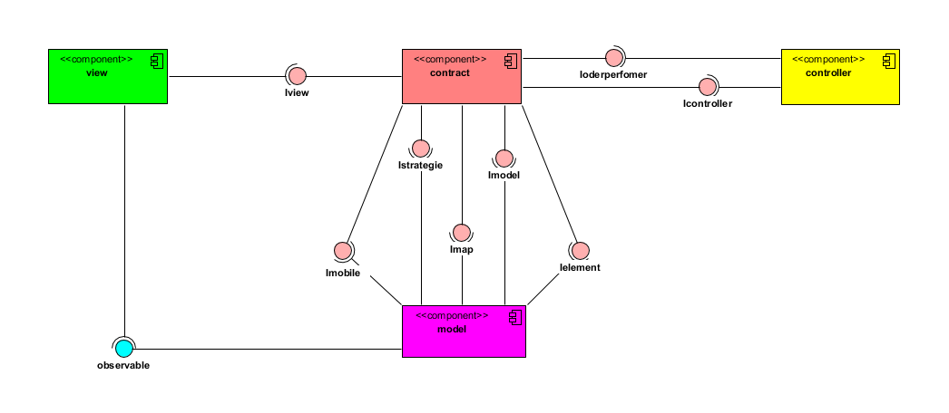
component diagram

Slide 26
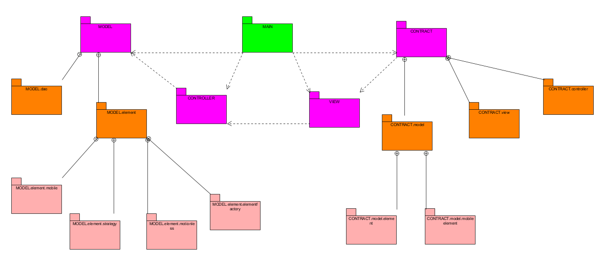
Package diagram

Slide 27
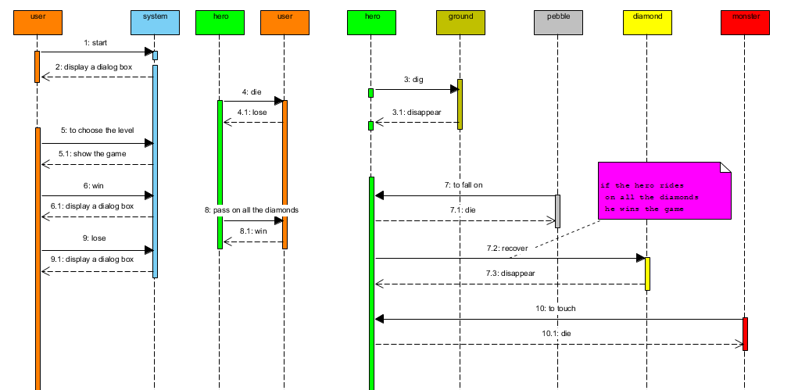
sequence diagram

Slide 28
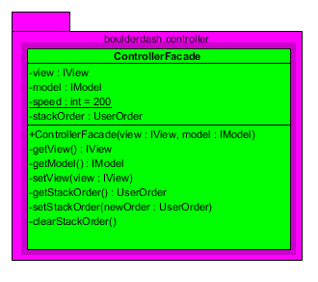
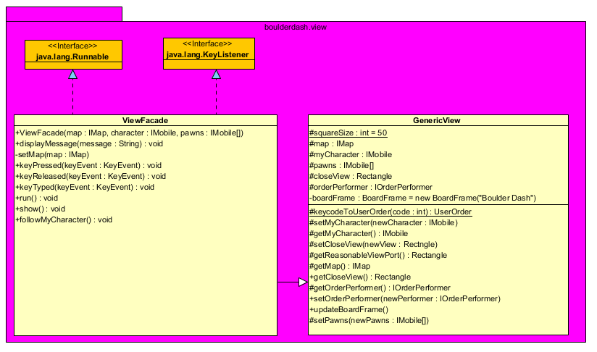
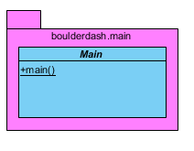
class diagram

Slide 29
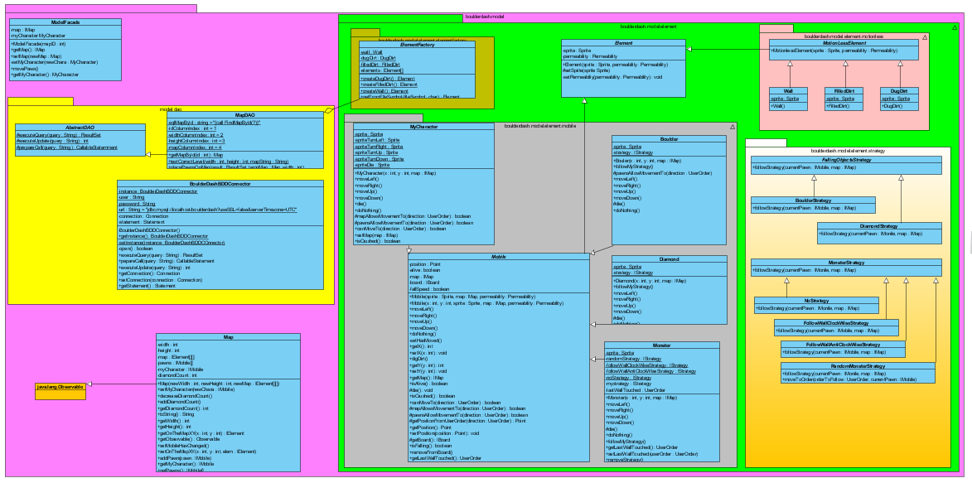
class diagram

Slide 30
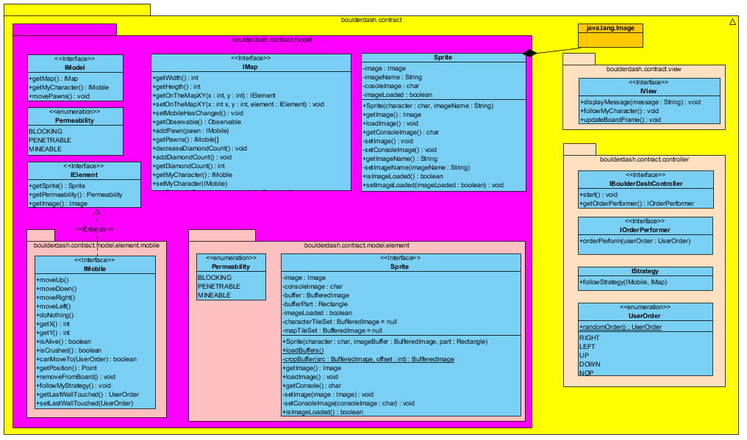
class diagram

Slide 31
8
Demo of the game

Slide 32
conclusion

Slide 33
Thank you for your kind attention

